Slide 1

Nicol Prism, Optical activity and Polarimeter
MD. GULAM MUSTAFA
Lecturer (Physics)
Department of Science & Humanities
Bangladesh Army International University of Science and Technology (BAIUST)
Syedpur, Cumilla-3501

Slide 2

Whatever we will discuss
Construction and working of Nicol Prism
Nicol Prism as an analyzer
Optical activity and specific rotation
Construction & working of Laurent’s half shade
polarimeter

Slide 3
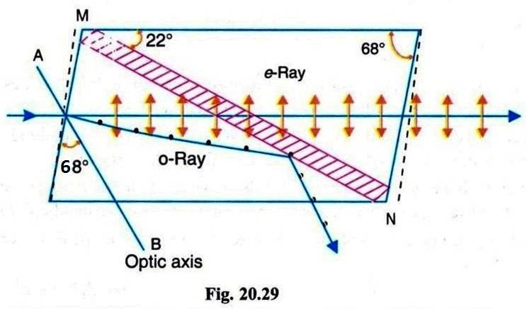
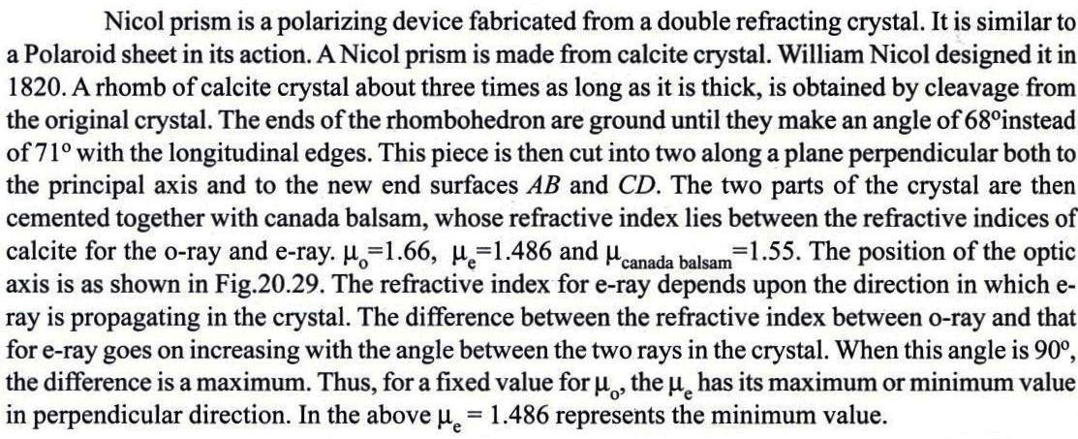
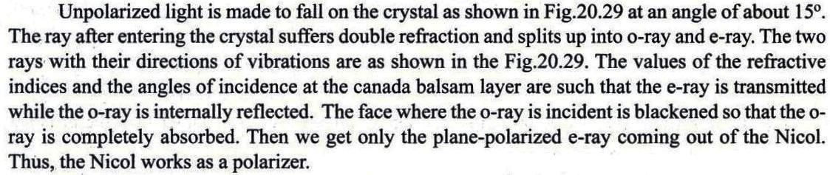
Nicol Prism
Construction:
As a polarizer:

Slide 4
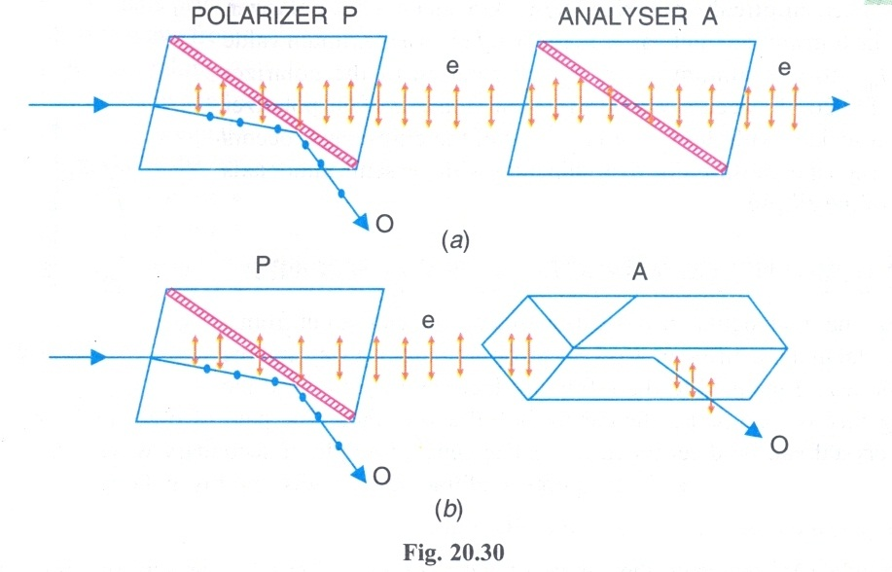
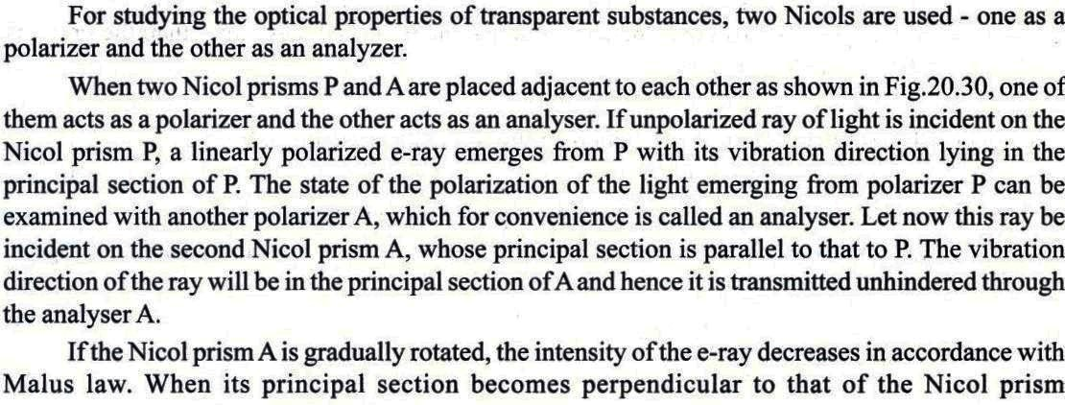
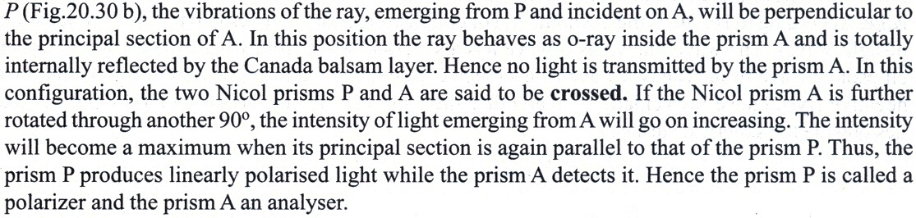
Nicol Prism as an analyzer

Slide 5
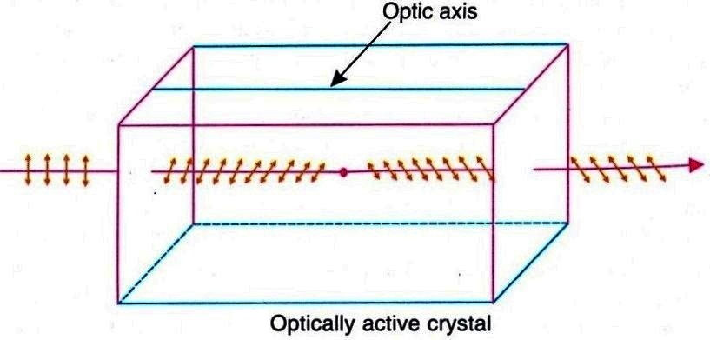
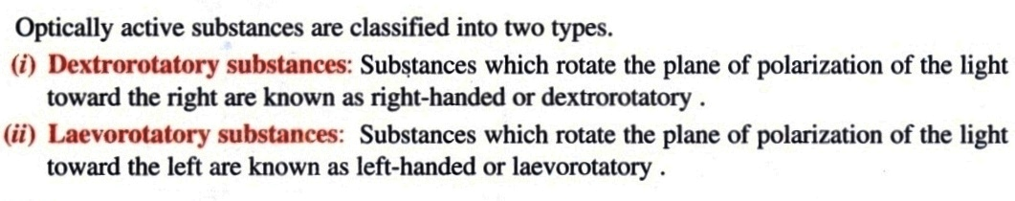
Optical activity
Certain crystals and solutions possess a natural ability to rotate the plane of vibration about the direction of propagation. That is, when a beam of polarized light propagates through certain crystals and solutions along the optic axis, the plane of vibration steadily turns about the direction of the beam. The ability to rotate the plane of vibration of polarized light by certain substance is called optical activity. Substances, which have the ability to rotate the plane of vibration passing through them, are called optically active substances. Quartz and cinnabar are examples of optically active crystals while aqueous solutions of sugar, tartaric acid are optically active solutions.

Slide 6
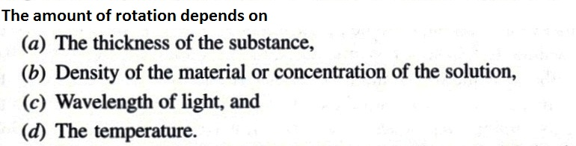
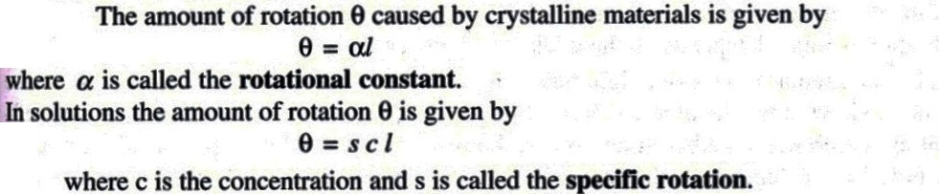
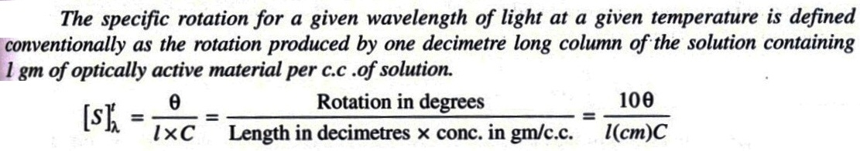
Specific rotation

Slide 7
A solution of glucose shows an observed rotation of +12° in a polarimeter tube of length 2 dm. If the concentration of the solution is 0.3 g/mL, calculate the specific rotation of glucose.
The specific rotation of a compound is +25°. If a solution has concentration 0.2 g/mL and is placed in a 1.5 dm tube, find the observed angle of rotation (θ).
A compound has specific rotation –40°. If the observed rotation is –16° in a tube of length 2 dm, find the concentration of the solution.
Related Mathematical Problems

Slide 8


